Slide 1
SQL
Basics

Slide 2
Over the course of this module
We will start by learning the basics of SQL: The SELECT statement and a few other common operators that we’ll use
We will then move to Joins – which is a way of joining two SQL tables together
Subsequently, we will look at Aggregations. That is, we’ve obtained some data, but how can create higher level ‘statistics’ about them
Finally, we will look at Subqueries – a technique which will allow us to queries within queries.

Slide 3
Pre-requisites
Download and install Postgres (https://www.enterprisedb.com/downloads/postgres-postgresql-downloads).
If you're on Linux and want our help to install, please let us know.
Download the Pagila database: https://github.com/devrimgunduz/pagila
Ensure that <INSTALL_DIRECTORY>\PostgreSQL\12\bin is in your path!

Slide 4
What is SQL?
SQL stands for Structured Query Language.
Language that we use to query databases.
Many different kinds of SQL databases out there: Postgres, MySQL, SQLite, MariaDB, etc.
All these languages have slight variations in their implementations of SQL, but most of what you learn regarding one of these database software’s can be transferred across the others.
Powerful that helps us answer questions that would otherwise be difficult to extract through more conventional means (e.g. spreadsheets).
Example: "What was the total revenue across from comedy films that were rented for 5 to 10 days".

Slide 5
The working example
We're going to be working with a database known as Pagila
Postgres port of an open-source sample database known as Sakila
Pagila is a database which models a DVD rental store. It features films, actors, film-actor relationships, and a central inventory table that connects films, stores, and rentals.
psql -c "CREATE DATABASE pagila;" psql -d pagila -f pagila-schema.sql OR psql -d pagila -f pagila-data.sql

Slide 6
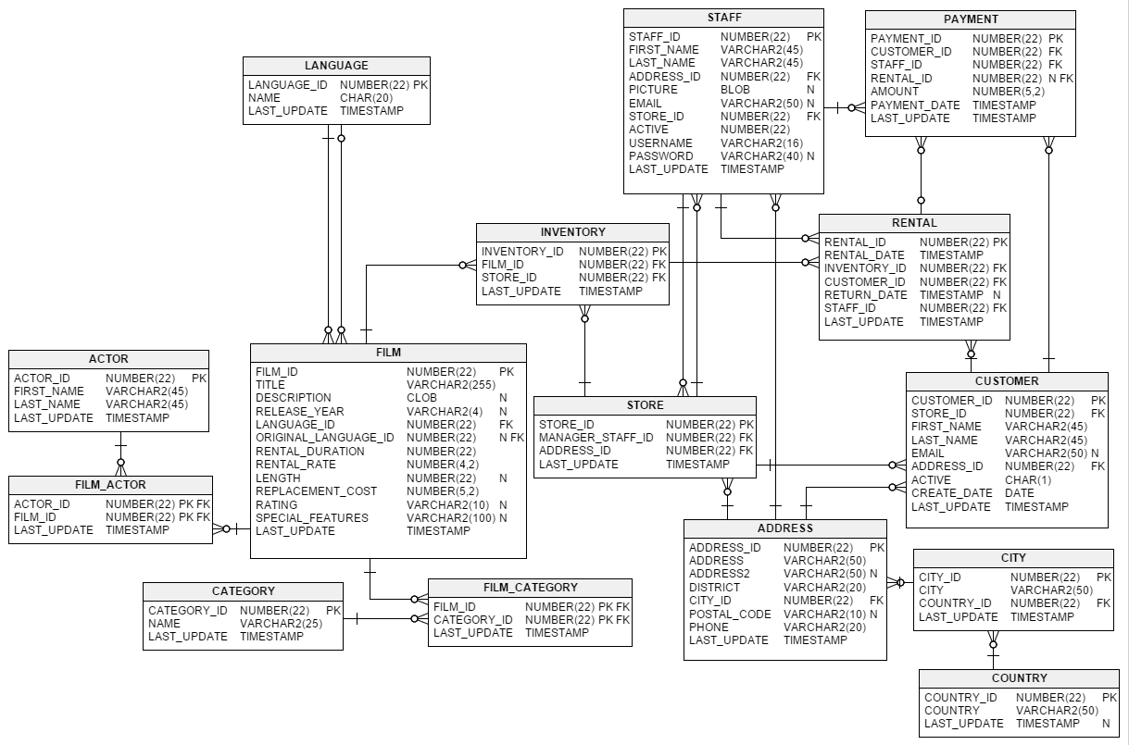

Slide 7
Entity Relationship Diagrams
Visually, databases are displayed through something known as an ERD (Entity Relationship Diagram)
Boxes have headings and variable names within the box.
Each box indicates a table in the database - a table being some collection of related data (e.g. address).
There are lines connecting two boxes together. These lines are known as relationships.
Won't dive too much into the technical breakdown of relationships
Important to notice that when two tables have a relationship with each other, we can reference an entry in one table from the other.
For example, we can reference a staff member from the Payment table. We'll formally introduce this later on.

Slide 8
Statements
Databases have four main statements, following the CRUD (Create, Read, Update, Delete) paradigm. Statements can essentailly be thought of as functions we want to perform over the database. Within a given database, relevant statements could include:
CREATE TABLE: A statement which creates a new table in the database
SELECT: Allows you to read and query the database to extract records you want
UPDATE: Allows you to update records within a table
DROP TABLE: Gives you the power to remove a table from a database
Notes:
Through this chapter, we will expose you to all the above statements, however the majority emphasis will be placed on **SELECT**. This is because, as a data scientist, more often than not, you'll be reading/pulling data from tables to transform and work with.

Slide 9
The SELECT Statement
Let's expose ourself to our first SQL statement! Let's run the query and see what we get returned back to us!
First, we'll connect to the Postgres shell:
psql -U <USERNAME> <DATABASE_NAME>.
The default username is postgres and we called our database pagila
Now we'll run the following query which returns all the information from the payment table:
SELECT * FROM payment;

Slide 10
SELECT * FROM payment;
The last argument is the actual name of the table we want to select information from. In this case, payment.
SELECT is our statement. This indicates to the database software that we want to select some columns from our database
Our argument for SELECT are the columns we want to select. Can you guess what * stands for?
If we wanted to only select a subset of columns from a given table, we would comma separate the column names (e.g. payment_id, amount, payment_data)
FROM is a keyword, which precedes the table name we are going to select our data columns from

Slide 11
The SELECT Statement
Statements terminate with a semi-colon
By convention, we use CAPITALS to indicate SQL keywords, and lowercase to indicate specific data.
SQL ignores whitespace
Notes:
Introduce to PGAdmin

Slide 12
LIMIT
By default, SELECT returns all the records that our statement matches.
LIMIT allows us to limit the number of records our statement returns.
It is always the last part of the query
SELECT * FROM payment LIMIT 10;

Slide 13
ORDER BY
ORDER BY allows us to specify which columns we want our returned data ordered by.
Returns data in ascending order by default
We can pass the DESC keyword after specifying the column to return data in descending order
We can order on almost any data type
Is placed after FROM and before LIMIT
SELECT * FROM film ORDER BY rental_rate DESC LIMIT 25;

Slide 14
ORDER BY
We can also sort by multiple columns
In our ORDER BY command, we can provide a list of columns to sort by, alongside whether we want each column to be ASC or DESC.
The sorting occurs from the leftmost column to the right.
SELECT * FROM film ORDER BY rental_rate DESC, length DESC;

Slide 15
Challenges!
Return all the information on all the actors in the database
Return the titles, year of film release, description and length of all films in the database
Return all info of 30 customers
Return the first name, last name and email addresses of 30 customers
Return all information about the highest payments made
Return the first 10 payments the rental company has made
Return the names of the 15 shortest films
Write a query which:
Returns 100 films, ordered by title first, and rental rate (descending) second
Returns 100 films, ordered by rental rate (descending) first, and title second
What’s the difference in the results when comparing the two?

Slide 16
WHERE
WHERE is a powerful statement – present in most queries you write
WHERE allows us to filter data based on some conditions
Common condition symbols are:
>, >= Greater than, greater than or equal to
<, <= Less than, less than or equal to
= Equal to
!= Not equal to
SELECT * FROM payment WHERE customer_id = 72

Slide 17
Arithmetic Operators
It’s possible to return a new column from a combination of existing columns
For example, we can return the rental price per day for every movie
We derive/compute this new column using mathematical operators!
+, -, *, /
Usually we alias the new column using the AS keyword
SELECT title, (rental_rate/rental_duration) AS rental_rate_per_day FROM film

Slide 18
Challenges!
Return 10 films who’s lengths are under 120 mins
Return the 10 longest films who’s rating are G
Hint: to search by string we need to wrap our query in SINGLE quotes (e.g. ‘G’)
Return all transactions where payment has been above $10
Return the (replacement) cost per minute of every movie
Return the top 10 most expensive films to rent, based on the rental rate per hour of the movie
Hint: Work out the rental rate per movie minute, and then perform another arithmetic operation on it

Slide 19
Comparisons and Logical Operators
SQL allows us access to operations that enhance our search queries
LIKE – Similar to WHERE =, but in cases you’re not entirely sure what you’re searching for
IN – Similar to WHERE =, but for more than one condition
NOT – Used to return opposite results from LIKE or IN (e.g. NOT LIKE or NOT IN)
AND & BETWEEN – Allows us to combine operations
OR – Allows us to find data where one of the conditions we provide to the query is true

Slide 20
LIKE
LIKE is typically performed on string based columns
Allows us to match strings using wildcards
One wildcard character in SQL is %
Represents zero or more characters
Case sensitive!
Remember to use single quotes in the query!
SELECT * FROM film WHERE description LIKE '%Drama%'

Slide 21
IN
IN can be used with both string and numeric data types
Essentially allows us to use an =, but over more than one condition
SELECT * FROM language WHERE name IN (‘English’, ‘Italian’)
SELECT * FROM film WHERE language_id IN (1, 2)

Slide 22
NOT
NOT allows us to inverse the results of the previous queries
SELECT * FROM category WHERE name NOT IN (‘Action’, ‘Animation’)
SELECT * FROM actor WHERE last_name NOT LIKE ‘%SON’

Slide 23
AND
We use AND when we want to run/check against multiple conditions
We can link as many expressions as we want
Of different types too… LIKE, IN, and NOT can all be linked by AND
SELECT * FROM payment WHERE payment_date >= '2017-01-25’ AND payment_date <= '2017-01-29’
SELECT * FROM payment WHERE payment_date < '2017-01-25' AND staff_id = 2

Slide 24
BETWEEN
When we want to specify a range between data on the same column (like we did in the previous slide), it is easier and cleaner to use BETWEEN
Works with dates, strings and numbers
SELECT * FROM payment WHERE payment_date BETWEEN '2017-01-25’ AND '2017-01-29’

Slide 25
OR
Similar to AND, OR combines multiple statements. However, with OR, only one of the conditions we specify needs to be true (instead of all cases as is the case with AND)
SELECT * FROM film WHERE rental_duration < 5 OR length > 120

Slide 26
Challenges!
Find all the cities which begin with “al-”
Find all the actors who’s first name doesn’t end in “EN”
Find all the actors who’s first name doesn’t end in “EN” and have an ID greater than 100
Find all the actors who’s first name doesn’t end in “EN”, have an ID greater than 100, and have a last name that ends in “D”. Order the results by the last name in descending order.
Return only the address of addresses in either the Alberta or QLD district
Return film titles and descriptions of films who’s lengths are between 80 and 100 minutes
Find actors who’s first name begins with “mi” or ends with “ing”
What’s the difference in results if you use an AND instead of an OR?
Return film titles and descriptions of films who’s lengths are between 80 and 100 minutes,
Return film titles and descriptions of films who’s lengths are between 80 and 100 minutes, and have a rental period between 5 and 7 days or have a replacement cost between $17 and $22

